Slide 1

Loot Boxes and potential links to gambling addiction Design Presentation
Michael Wolf

Slide 2
Project Aim
The aim of the project is to find potential links between video game loot boxes and gambling and a gateway to gambling addiction.

Slide 3
Main Objectives
Create
Create a loot boxing opening simulator in Unity Game Engine that simulates real world systems.
Measure
Measure the participants choices and record them in order to evaluate them.
Evaluate
Evaluate the results and compare them to the research into gambling and gambling addiction, considering the factors that define a person as having a gambling addiction.

Slide 4
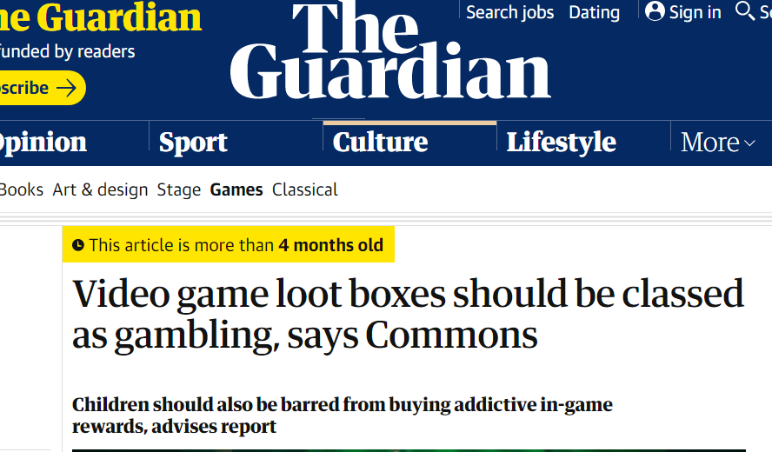
Rationale
The reason for this project is to evaluate the effects loot box systems have on users to see if there is indeed a connection between loot boxes and gambling addiction.
A Loot box simulation was chosen in favour on just surveys or research to witness the reactions of users in real time in the hope it would give more reliable results.
Fig 1: The Guardian Article about video game loot boxes being classes as gambling

Slide 5
Design Concept
The key concept for the design is to replicate current loot box systems within video games as closely as possible.
Users will be given a set amount of ‘Virtual Coins’ which they can use to open Loot Boxes within the Simulation.
Each loot box will award the player with prizes, the more common prizes being more virtual coins to spend and the rarer ones being physical rewards in the form of chocolates or something similar.
Once the user has used the coins given to them, they either choose to work away with the physical prizes they have won, or use the coins they have one to have another go at opening loot boxes, in doing so forfeiting the physical rewards they have won so far.
The user’s choices of both which tier of loot box they pick and whether they choose to play again or leave with what they have won will be recorded.

Slide 6
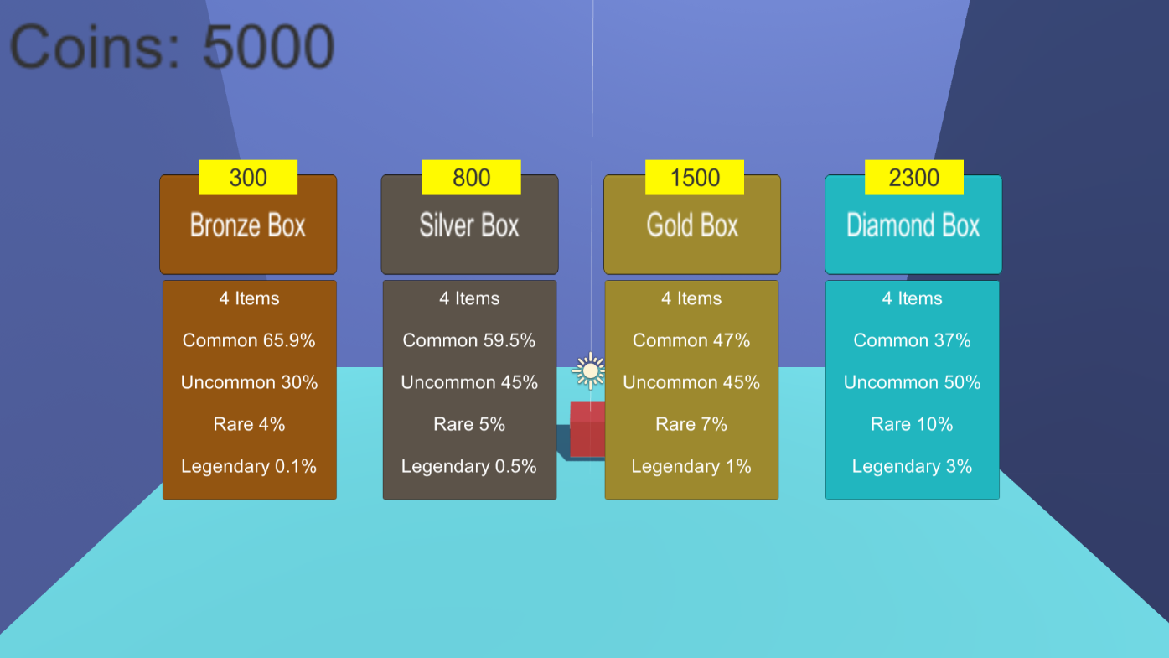
Progress
A Prototype Application has been designed that allows the user to choose different tiers of loot boxes to open. Each tier costs a different amount of Coins to open but has increasing odds of getting better rewards. (Prototype Exe is including with project files).
Fig 2: Screenshot of Prototype Loot Box Simulation Application

Slide 7

Future plans
Add finishing touches to simulation in preparation for testing.
Finalise physical reward system.
Begin Testing Loot Box Simulation in order to collect data.
Evaluate the data and compare to research into gambling and gambling addiction.

Slide 8
Thank you
Any Questions?

